Slide 1
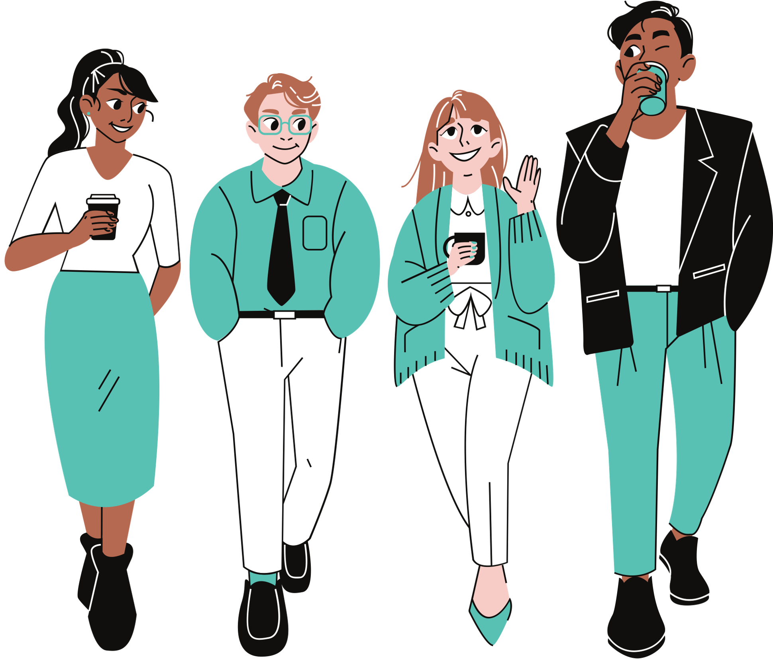
Life-Situation Interventions:
Interpersonal Relationships and Communication
Week 10
Notes:
Designed and created by Dandi Yang. Do not duplicate or upload with the express written permission of the author.

Slide 2

Notes:
Before we begin, please feel free to open up this video, keep in the background and and enjoy some chill, lo-fi beats as you navigate through this lecture. Or watch the video in between work sessions to destress and refocus.

Slide 3
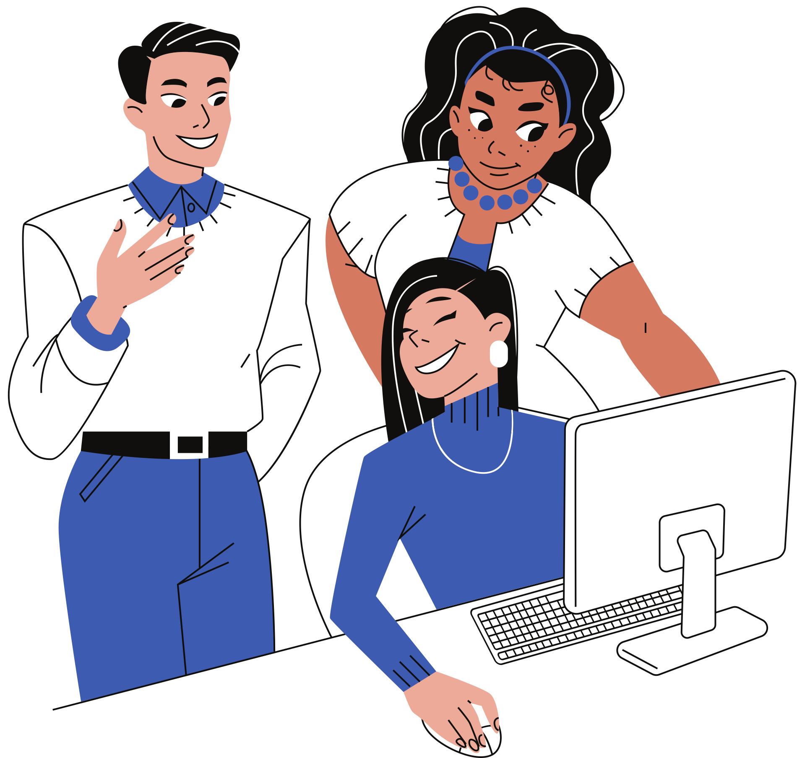
Overview
Asserting Yourself
Assertiveness and Stress
Conflict Resolution
Communication
Emotional Intelligence
Social Support Networking

Slide 4
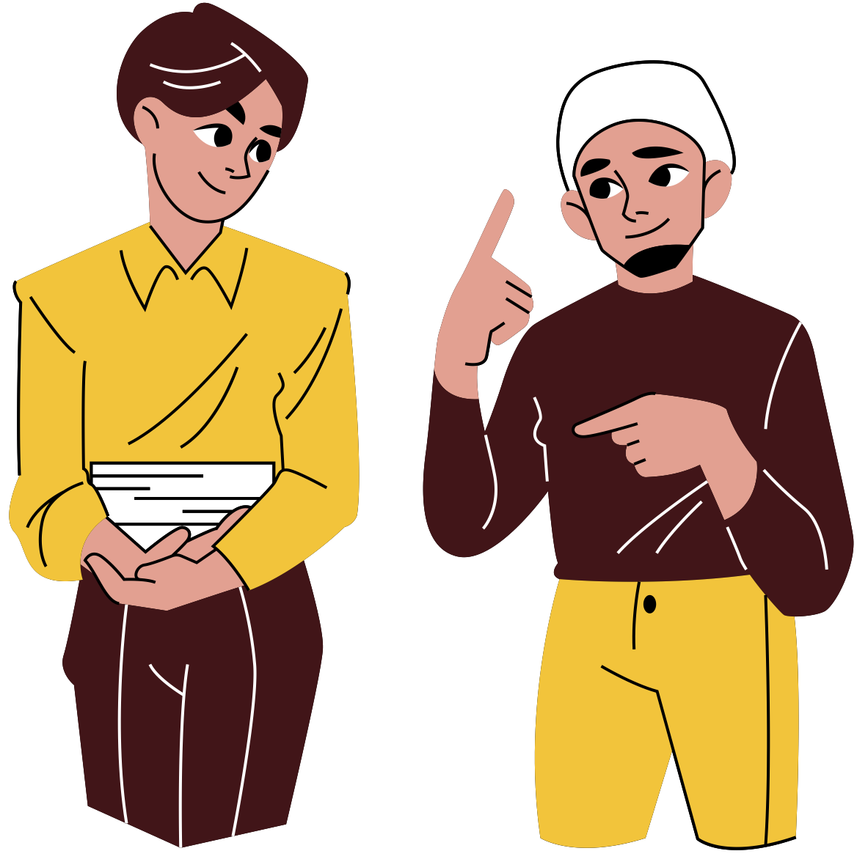
Patterns of Behaviour
Assertive behaviour: acting to satisfy one’s own needs, but not at the expense of others’ rights
Non-assertive behaviour: giving up wishes and needs in order not to upset others
Aggressive behaviour: seeking to dominate others and meet needs at the expense of others’ rights

Slide 5
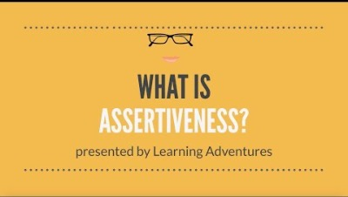
Notes:
https://www.youtube.com/watch?v=Xsqx4EsrWgU

Slide 6


Assertiveness Theory
The premise that everyone has certain basic rights
We are sometimes taught that acting consistently with these rights is unacceptable
Notes:
Assertiveness is the ability to honestly express your opinions, feelings, attitudes, and rights, without undue anxiety, in a way that doesn't infringe on the rights of others.
Being clear about what you feel, what you need and how it can be achieved
Being able to communicate calmly without attacking another person
Saying "yes" when you want to, and saying "no" when you mean "no" (rather than agreeing to do something just to please someone else)
Being able to talk openly about yourself and being able to listen to others
Being able to give and receive positive and negative feedback
If you don't know how to be assertive, you might experience :
Depression. From anger turned inward, a sense of being helpless, hopeless, with no control over your life.
Resentment. Anger at others for manipulating or taking advantage of me.
Frustration. How could I be such a wimp? Why did I let someone victimize me?

Slide 7
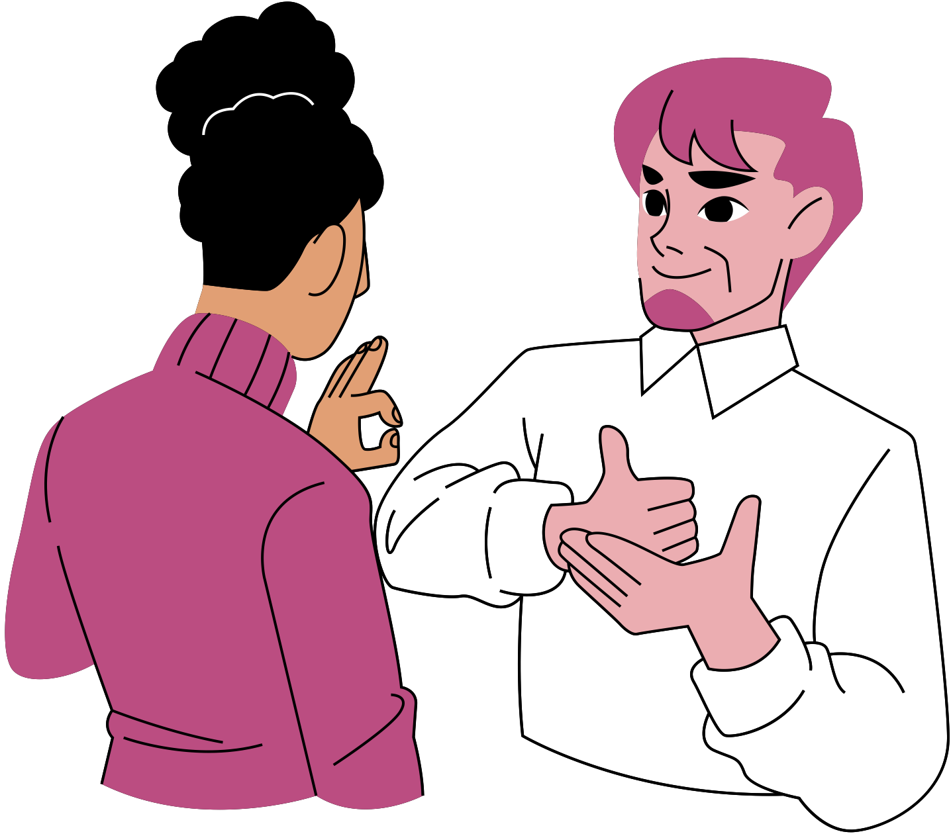
Nonverbal Assertiveness
Nonverbal assertiveness: body language consistent with verbal assertiveness
Assertiveness is not only what you say but how you say it
Standing up straight
Facing the other person directly
Maintaining eye contact
Speak in a clear and steady voice
Notes:
General attitude:
Voice, eyes, body posture, hands, all can determine your level of assertiveness.
While listening:
Paying close attention to what is being said
Assured manner
Showing concern and strength
Seeking fairness
Relaxed gestures
Making eye contact but not staring
Voice is firm, warm

Slide 8
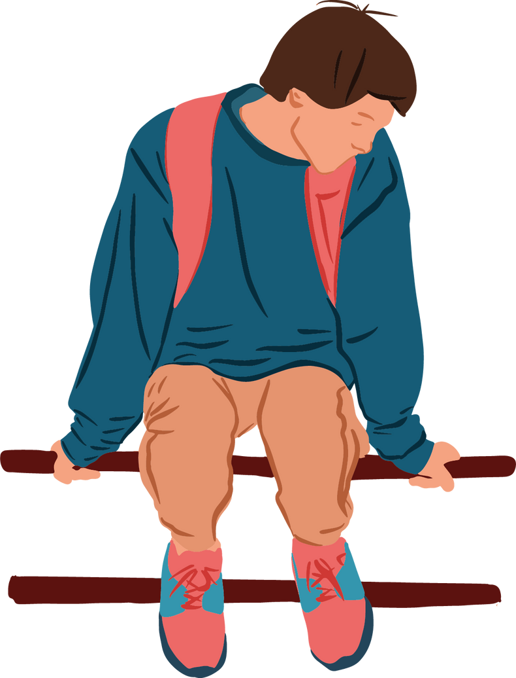
Nonverbal Nonassertive Behaviour
Passive Behaviour
Lack of eye contact
Looking away or down
Shifting weight or swaying
Hesitancy when speaking
Notes:
PASSIVENESS
Not expressing feelings, needs, and ideas; ignoring personal rights; and allowing others to infringe upon them. Non-assertive persons often let other people choose for them and end up feeling disappointed in themselves and angry with them; at best, they can be described as passive, at worst as a doormat. People often choose non-assertive behavior to avoid unpleasant situations, tension, conflict, and confrontation.
Not saying much but hoping someone will guess what you want.
Looking like you don’t mean what you say.
Willing to lose.
Voice is weak, hesitant, soft, rising inflection at end of statements.

Slide 9

Nonverbal Aggressive Behaviour
Glaring at the other person
Pointing your finger
Shouting
Clenching your fists
Putting your hands on your hips
Crossing arms
Notes:
Characteristics of aggressive behavior include expressing your feelings, needs, and ideas at the expense of others.
Aggressive persons stand up for their rights, but ignore the rights of others; they may dominate or humiliate other people.
While this behavior is expressive, it is also defensive, hostile, and self-defeating.
Exaggerated show of strength
Sarcastic style
Air of superiority
Need to win
Eyes: Narrowed, cold staring
Expressionless, as though looking through you

Slide 10
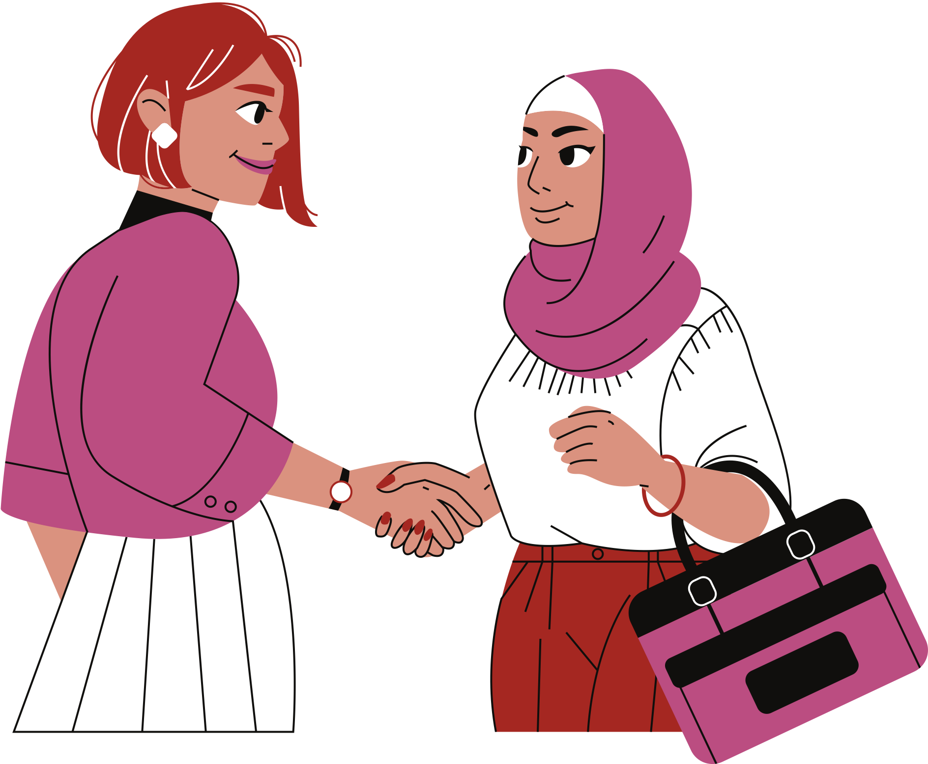
Assertiveness and Stress
Assertiveness creates:
Fewer conflicts with others
More needs being met
Stronger social relationships
Notes:
Assertive people tend to have fewer conflicts in their dealings with others, which translates into much less stress in their lives.
They get their needs met — which also means less stressing over unmet needs, and help others get their needs met, too.
Aggressiveness tends to alienate others and create unnecessary stress. Those on the receiving end of aggressive behavior tend to feel attacked and often avoid the aggressive individual.
Passive people aim to avoid conflict by avoiding communication about their needs and feelings, but this behavior damages relationships in the long run. They may feel like victims, but continue to avoid confrontation, becoming increasingly angry until, when they finally do say something, it comes out aggressively.

Slide 11
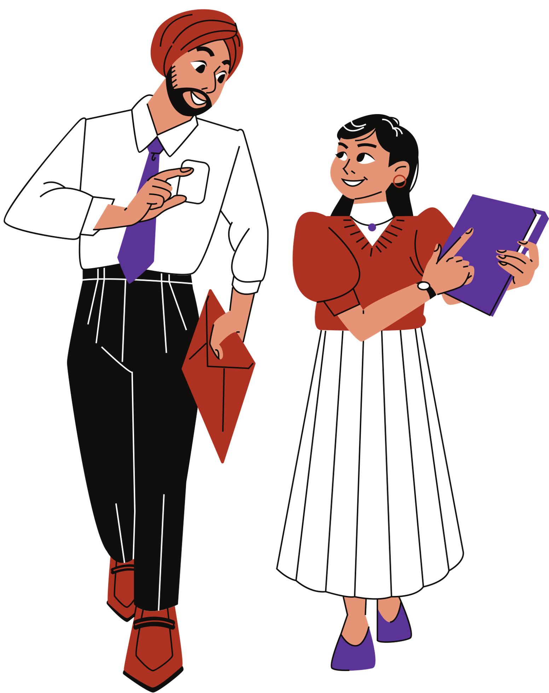
Verbal Assertiveness
Being more verbally assertive
DESC formula divided into four parts:
Describe situation
Express feelings
Specify change
Consequences of the outcome, regardless of change
Notes:
Describes a behavior that has a negative impact on the speaker. Example: “When you start shouting, I want to end the conversation immediately.”
Expresses a feeling in response to the behavior. Example: “I feel attacked and defensive.”
Specifies the desired change in behavior. Example: “I need you to tell me clearly and calmly what I’m doing to upset you so I can understand my role in this.” Or Specifies the effect the behavior had on you and others. Example: “Your shouting disrupts our co-workers and our ability to focus on our customers.” Consequences if the desired change does not occur (Note: Step 4 is not always possible or necessary and is not only a negative consequence). Example: “or I will ignore you.” or “so that we can work more collaboratively”

Slide 12
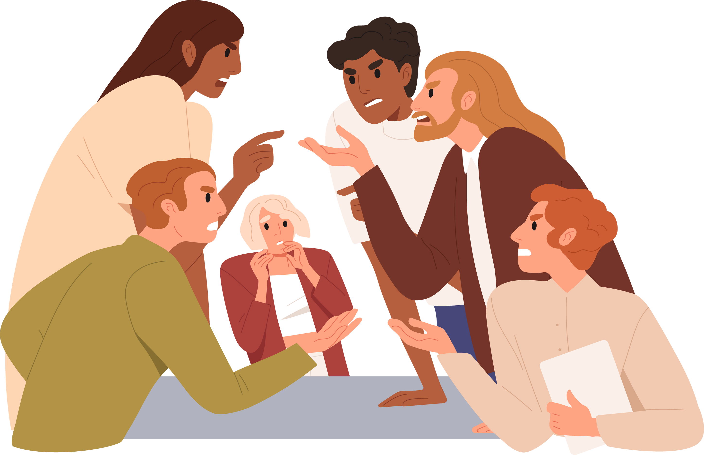
Conflict
A struggle between parties who perceive:
Incompatible goals
A difference of ideas or opinions

Slide 13
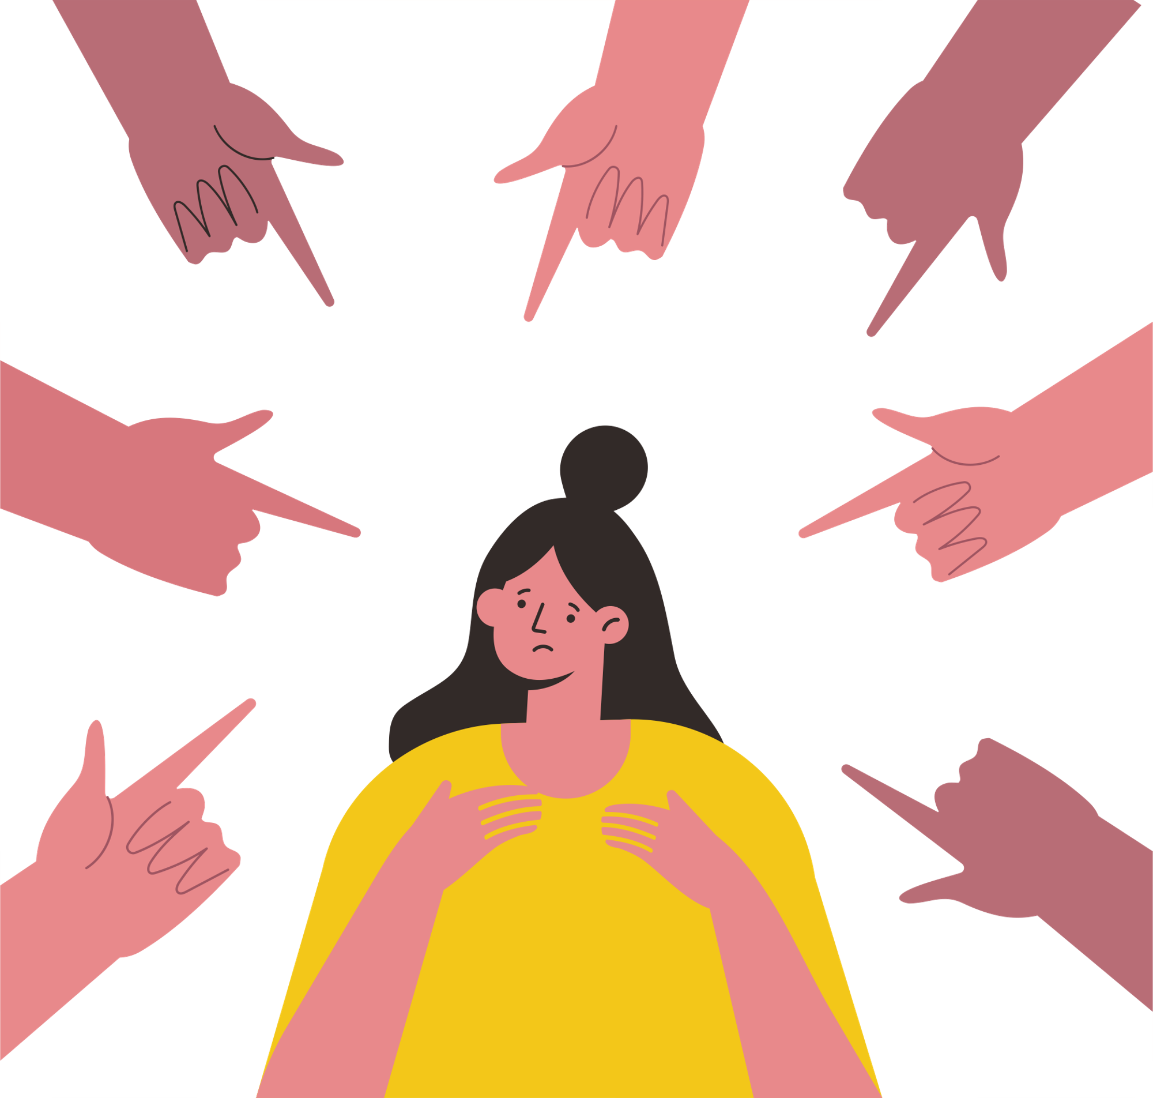
Styles of Conflict Resolution
Avoidance
Accommodating
Competing
Compromising
Collaborating
Notes:
Avoiding – This is when you simply avoid the issue. You essentially pretend that it never happened or doesn’t exist. Some examples of avoidance or withdrawal include pretending there is nothing wrong, stonewalling or completely shutting down.
Accommodating – Someone who accommodates the other person in a conflict prefers to satisfy the concerns of the other person, thereby neglecting his own concerns. Accommodation carries with it an element of self-sacrifice. This mode might involve selfless generosity or charity or yielding to another’s point of view.
Competing – An individual who competes pursues his or her own interests without regard to the other person’s goals and seeking to impose his power in order to win his position. Competing might mean standing up for one’s rights, defending a position believed to be right, or simply trying to win. Compromising – The individual who prefers to compromise wants to find an expedient, mutually acceptable solution. Compromising addresses an issue more directly than avoiding, but does not explore it in as much depth as collaborating. Compromising might mean splitting the difference, exchanging concessions, or seeking a quick middle-ground position. Collaborating – In collaboration, the individual prefers to work with the other person to find a solution that fully satisfies the concerns of both. This is the best way to achieve the win/win solution: one where each party feels that he or she achieved his or her goals. It involves exploring an issue to identify the underlying interests of the parties in order to arrive at an outcome that meets both sets of concerns. Collaborating might take the form of exploring a disagreement to learn from each other’s insights, or looking for a creative solution to an interpersonal problem.

Slide 14
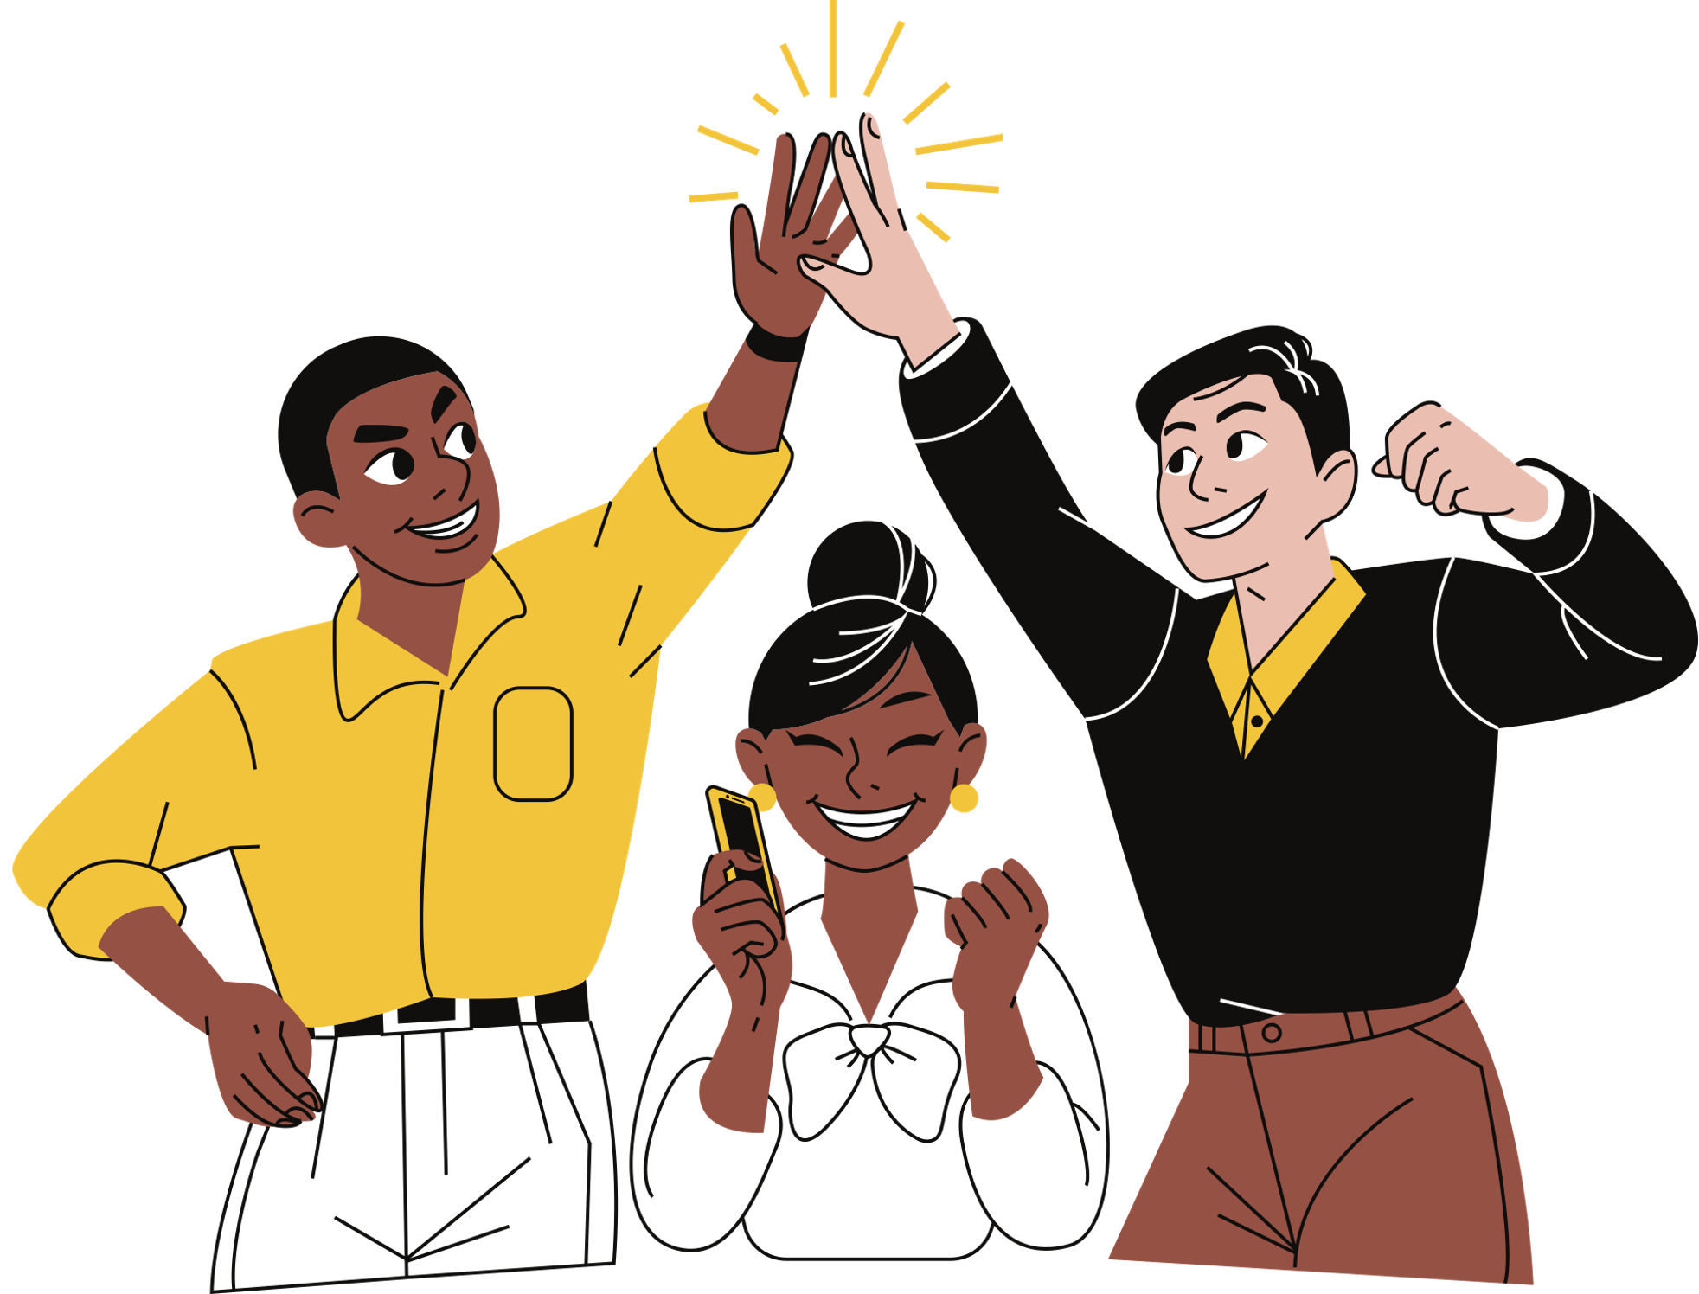
Conflict Resolution Techniques
Active/reflective listening: repeat or paraphrase the other person’s words and feelings
Identify your position: state thoughts and feelings about the situation
Explore alternative solutions: brainstorm and collaborate
Use “And” instead of “But”
Adds rather than discounts
Use “I” statements
Avoids defensiveness
Avoid “Why?” questions
They can be perceived as criticisms
Using body posture to communicate attention
Notes:
Using And Instead of But: Instead of "you are good at x, but you're bad at y," it can be "you are good at x, and if you keep working at y, you'll be even better." Feedback should be constructive, so keep it short and sweet, and avoid bringing down the people you're trying to help.
Why Question: "Why are you still smoking? You have many breathing issues that will only get worse." Better Question: "I am concerned about your breathing issues. We will explore different options to help you stop smoking.” I Statement: I feel (state a feeling) why you do (unwanted behaviour). It’s hard to dispute a person’s feelings./
“I feel uncomfortable when you leave your dishes unwashed because they are starting the smell and making the environment tough to live in.”

Slide 15
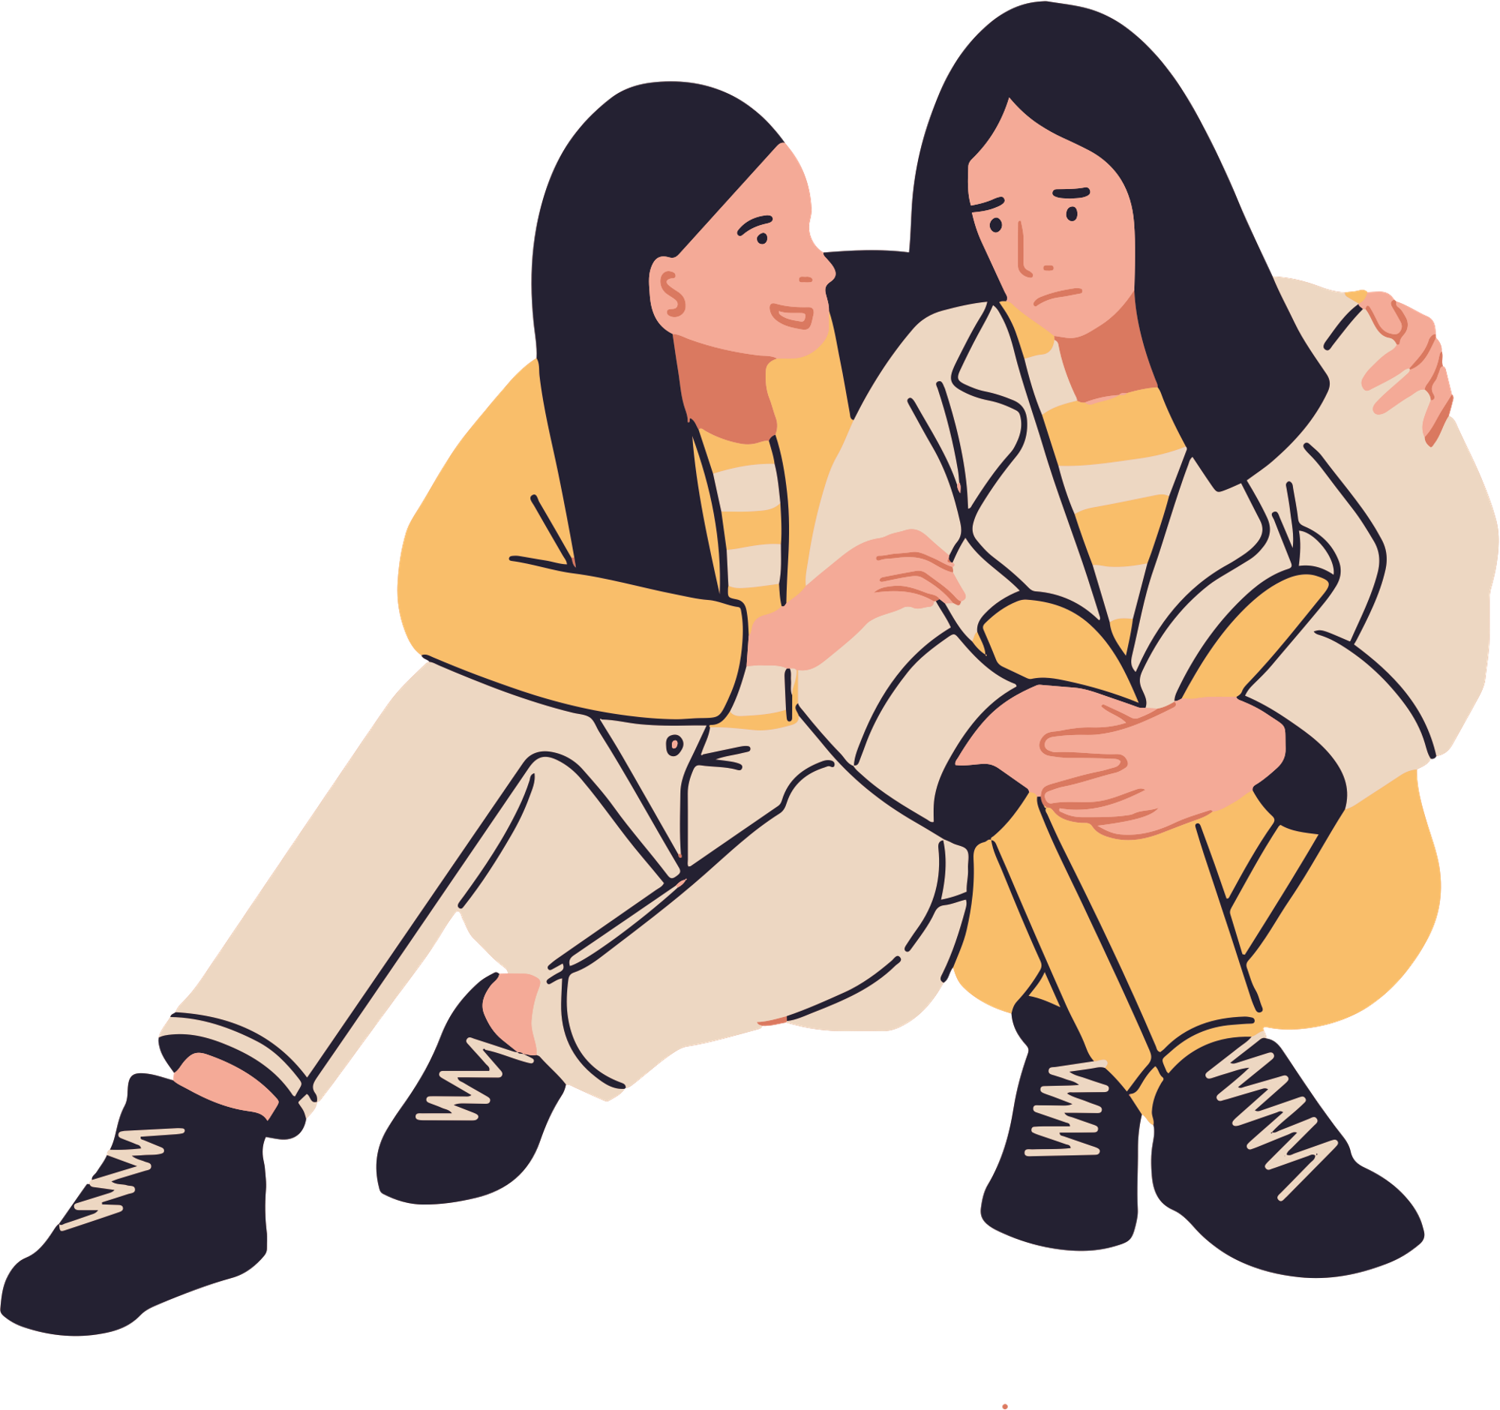
Emotional Intelligence
Definition: the ability to accurately identify and understand one’s own emotional reactions and those of others, and to regulate one’s emotions and to use them to make good decisions and act effectively
Notes:
Emotional awareness; the ability to harness emotions and apply them to tasks like thinking and problem solving; and the ability to manage emotions, which includes regulating your own emotions and cheering up or calming down other people.

Slide 16

Goleman’s Model of Emotional Intelligence
Self-awareness.
Self-regulation.
Motivation.
Empathy.
Social skills
Notes:
Self-awareness
The ability to recognize and understand personal moods and emotions and drives, as well as their effect on others. Self-awareness depend on one's ability to monitor one's own emotion state and to correctly identify and name one's emotions.
Self-regulation
The ability to control or redirect disruptive impulses and moods, and the propensity to suspend judgment and to think before acting. Hallmarks include trustworthiness and integrity; comfort with ambiguity; and openness to change.
Motivation
A passion to work for internal reasons that go beyond money and status -which are external rewards, - such as an inner vision of what is important in life, a joy in doing something, curiosity in learning, a flow that comes with being immersed in an activity. A propensity to pursue goals with energy and persistence. Hallmarks include a strong drive to achieve, optimism even in the face of failure, and organizational commitment.
Empathy
The ability to understand the emotional makeup of other people. A skill in treating people according to their emotional reactions. Hallmarks include expertise in building and retaining talent, cross-cultural sensitivity, and service to clients and customers.
Social Skills
Proficiency in managing relationships and building networks, and an ability to find common ground and build rapport. Hallmarks of social skills include effectiveness in leading change, persuasiveness, and expertise building and leading teams.

Slide 17
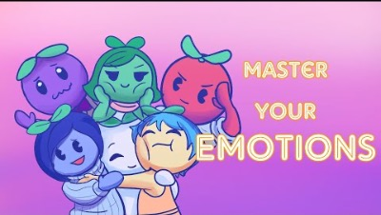
Notes:
5 Simple Ways to Develop Emotional Intelligence video: https://youtu.be/JEBFZ0U7ZZI?t=10
Improve Emotional Intelligence
Observe how you react to people
Look at your behaviour, nonverbal behavior.
Do a self-evaluation
Those with good emotional intelligence are aware of their emotional, strengths, weakness.
Examine how you react to stressful situations
Take responsibility for your actions
Examine how your reactions will affect others, before you take those actions

Slide 18
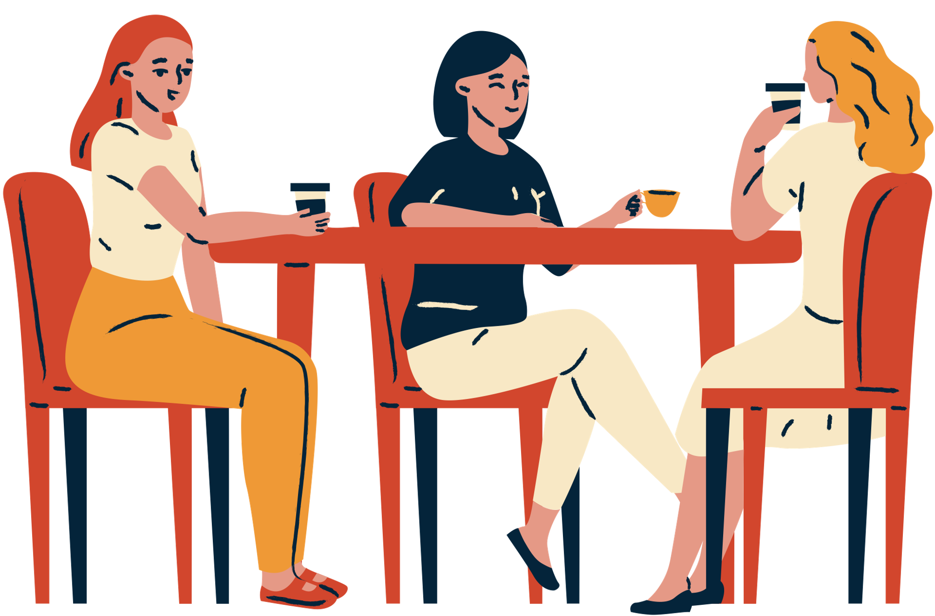
Social Support
Belonging, being accepted, being loved, or being needed
Individual’s belief that they are:
Cared for and loved
Belong to a network of communication
Has mutual obligations with others in the network
Notes:
Social support is essential not only to stress management but even good health. Relationships act as stress buffers, and having healthy relationships actually improves the quality of our lives.
Social support:
Involves being accepted, loved and needed just for being yourself
Can reduce stress and prevent the negative consequences of stress
Comes in various forms such as instrumental (boss, teacher, etc.), emotional (partner, family member, etc.), informational (counselor, religious leader, etc.), or appraisal (affirmation and feedback in general).
Just as a healthy relationship can do wonders, we see that social isolation and unhealthy relationship can have a severely negative effect on your quality of life, and increase your levels of stress. Maybe you have a relationship like this in your life? Someone who causes you stress but who you maintain a relationship with. What if you could improve your relationship with this person?

Slide 19
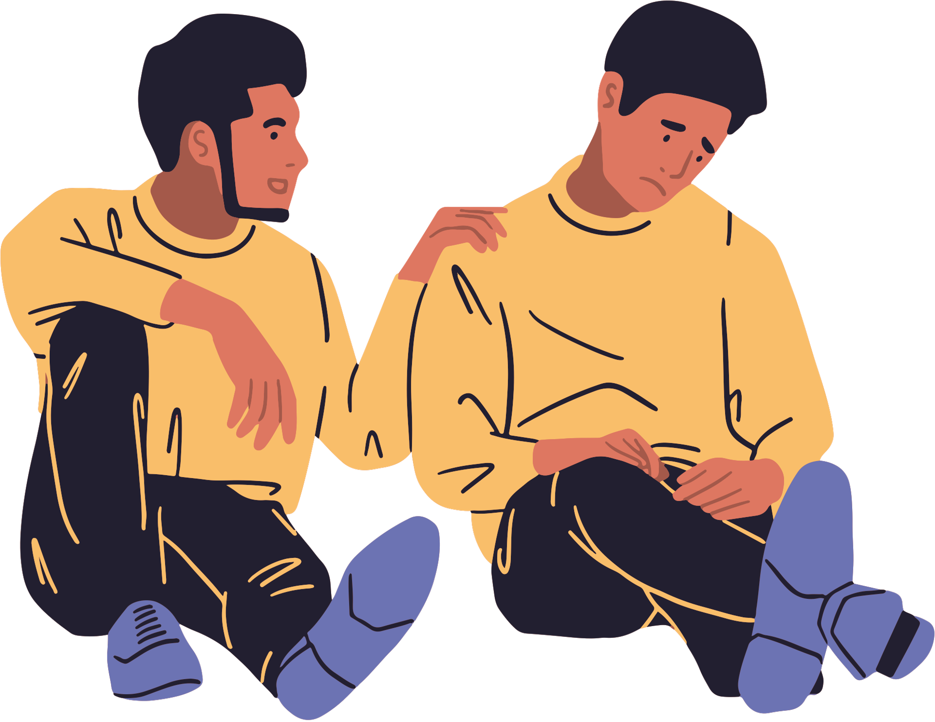
Benefits of Social Support
Direct effect theory
Social support as a means of preventing stressors from occurring in the first place
Stress buffering theory
Social support helps after a stressor is encountered to help prevent that stressor from resulting in negative consequences
Notes:
Direct effect: Social support has a positive effect on health overall. For example, the social support people get through ordinary interactions, such as talking to a your friend about your day, enables you to keep your emotions in check, thereby improving your mental health.
The stress-buffering model says that social support can help people cope with a stressful situation by protecting (or buffering) them from the bad health effects linked to stress. For example, your partner cooking dinner after you come home from a long day at work.
Social support creates:
Sense of belonging. Spending time with people helps ward off loneliness. Just knowing you're not alone can go a long way toward coping with stress.
Increased sense of self-worth. Having people who call you a friend reinforces the idea that you're a good person to be around.
Feeling of security. Your social network gives you access to information, advice, guidance and other types of assistance should you need them. It's comforting to know that you have people you can turn to in a time of need.

Slide 20
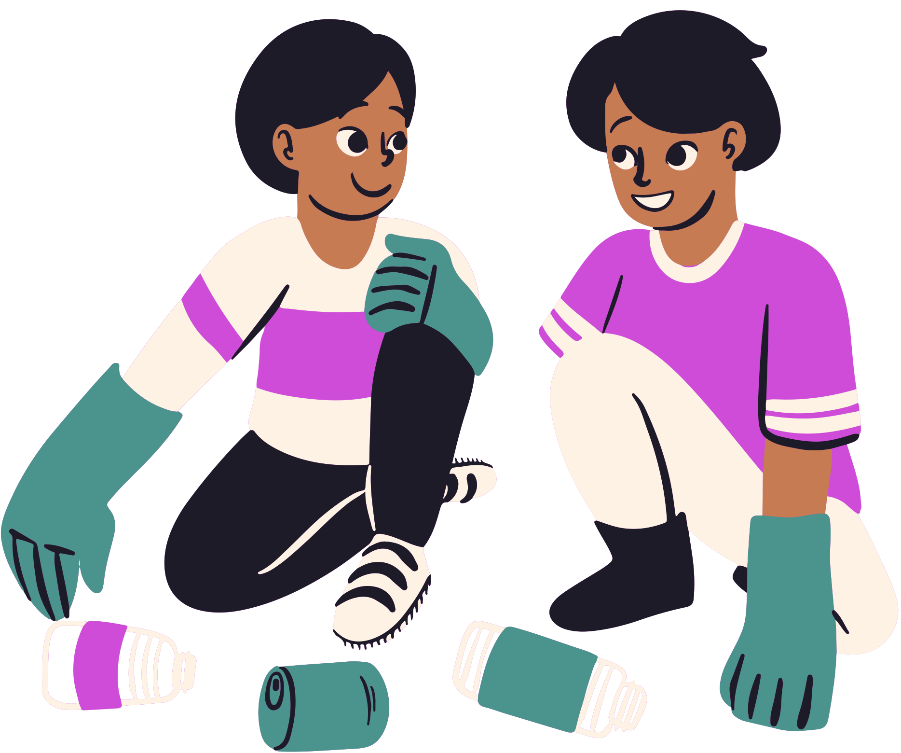
Types of Social Support
Instrumental support
Direct help and service?
Emotional support
Trust and comfort in sharing intimate thoughts
Informational support
Advice, suggestions
Notes:
Instrumental: Tangible aid and service- Her husband decides to work from home 2 days per week to baby-sit the children while she attends her chemotherapy
Emotional: Expressions of empathy, love, trust and caring- Close friends and family members provide hope and a listening ear
Informational: Advice, suggestions, and information- Doctors provide facts about breast cancer and guidance during the treatment process Her mother offers advice about her own chemotherapy treatment 3 years prior

Slide 21
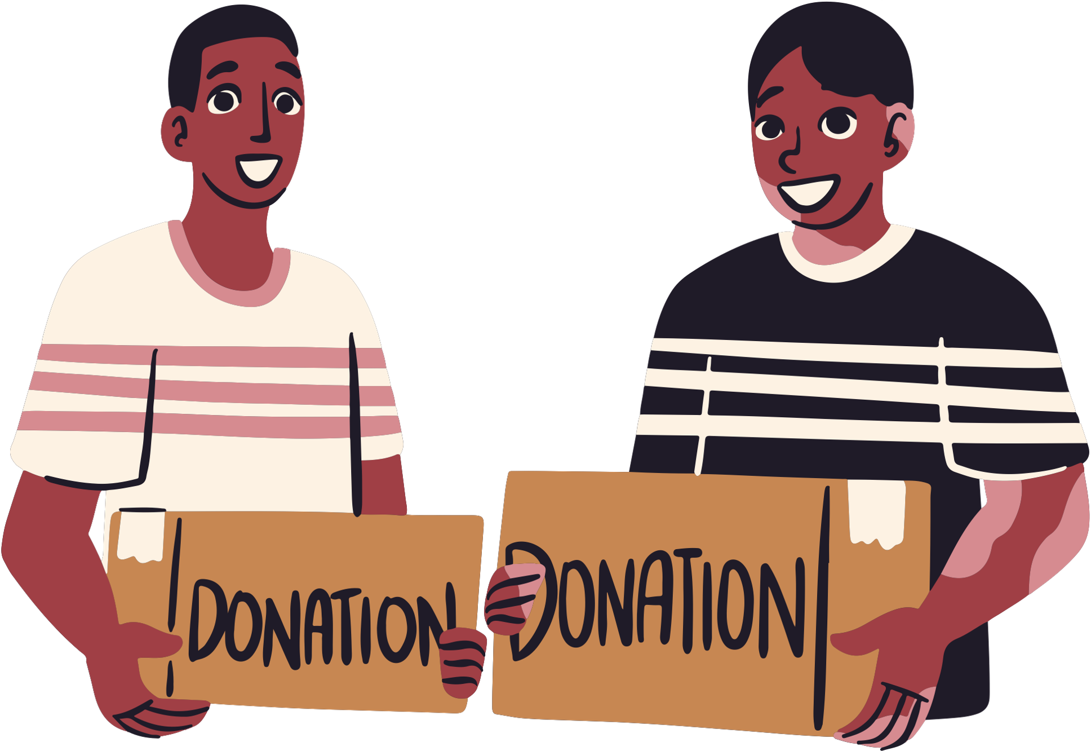
Building a Social Support Network
Volunteer:
Pick an cause that important to you and get involved
Join a gym or a fitness group:
Not only are you getting physically fit, but you can also make friends while you exercise. As a bonus, they will help keep you motivated!
Take a class:
College is a great time to meet people who share similar pursuits
Online:
Social networking is a great way to stay connected. There are tons of resources online to help you through almost any situation. Remember to stick to the reputable ones.

Slide 22

Maintaining a Strong Social Support System
Practice conflict resolution technique
Be a good listener
Be caring and open with others – appreciate others
Overcome your fear of social situations
Don’t overdo it – don’t overwhelm friends and family with calls and texts
Give back – be available for others when they need you
Notes:
Remember that a goal of building your social support network is to reduce your stress level, not add to it. Watch for situations that seem to drain your energy. For example, avoid spending too much time with someone who is constantly negative and critical. Similarly, steer clear of people involved in unhealthy behaviors, such as alcohol or substance abuse.
Taking the time to build a social support network is a wise investment not only in your mental well-being but also in your physical health and longevity. Start making more friends or improving the relationships you already have. Whether you're the one getting the support or the one doling out the encouragement, you'll reap rewards.

Slide 23
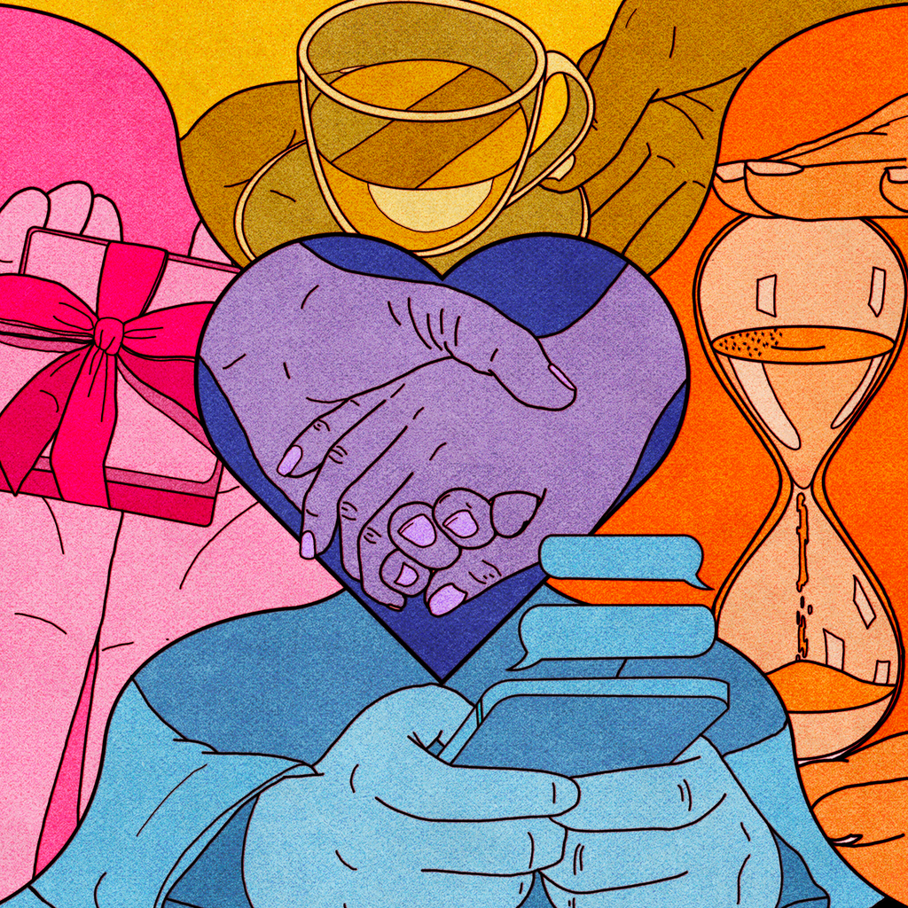
Love Languages
People tend to naturally give love in the way that they prefer to receive love, and better communication between people can be accomplished when one can demonstrate caring to the other person in the love language the recipient understands.
Words of affirmation
Quality time
Receiving gifts
Acts of service
Physical touch
Notes:
Words of affirmation
These are verbal expressions of care and affection. Think: "Thanks for putting the kids to bed" or "You looked really nice today." Conversely, insults can be particularly upsetting to people who favor words of affirmation.
Quality time
Love and affection are expressed through this love language when someone gives someone else their undivided attention. People with this love language are looking for quality over quantity. So, when you get together, they feel loved if you are present and focused on them.
Receiving gifts
To a person whose love language is receiving gifts, gift-giving is symbolic of love and affection in their mind. They treasure not only the gift itself but also the time and effort the gift giver put into it. What's more, they do not necessarily expect large or expensive gifts, the love language receiving gifts is more what is behind the gift that appeals to them.
Acts of service
When someone's primary love language is acts of service, they feel loved and appreciated when people do nice things for them. Whether it's helping with the dishes or putting gas in the car, little acts of service go straight to the person's heart. They love when people do little things for them and often can be found doing little things for others.
Physical touch
A person with this love language feels loved through physical affection. Those who have physical touch as their primary love language feel loved when their partner shows physical affection in some way like holding their hand, touching their arm, or giving them a massage at the end of the day.

Slide 24

Notes:
Find out your love language
https://www.goodnet.org/articles/5-love-languages-which-one-are-you
You don’t have to watch the whole thing- they’re just my favourite YouTubers so I wanted to share ☺
https://www.youtube.com/watch?v=U4FTBKpxw1U

Slide 25
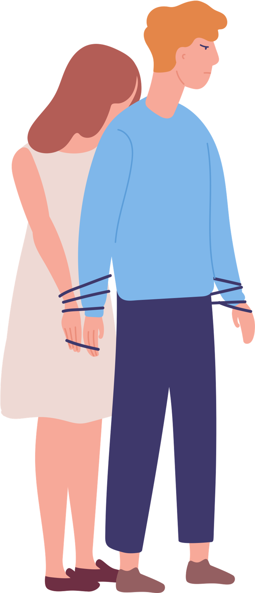
Co-Dependency
Co-dependency is unhealthy kind of “love”
An addiction to another being, but in a way that minimizes your own feelings. It has similar roots to addiction.
Defined as excessive emotional or psychological reliance on a partner (or friend), one who typically needs a lot of support.
Can be an unhealthy coping mechanism for stress
Notes:
May experience one or more of the following traits:
Care-taking role: attracted to needy people in a desire to take care of them
Low self-worth: an inability to see ones own value
Obsessive: likes fixing others, and will work hard to do so
Controlling: will try to control others in an effort to manage or act out a previous trauma
Dependency: a fear of losing anything or anyone
Poor communication: trouble communicating what they truly mean to others or will rely on others to communicate for them
Weak boundaries: continuously allowing others to do what they want at the expense of their own feelings.
Lack of trust: fear of abandonment
Anger: absorbs feelings of hurt & anger from others
Sexual issues: difficulty being forthright with partners

Slide 26

Notes:
https://www.youtube.com/watch?v=Qy_2xDcjC1E

Slide 27
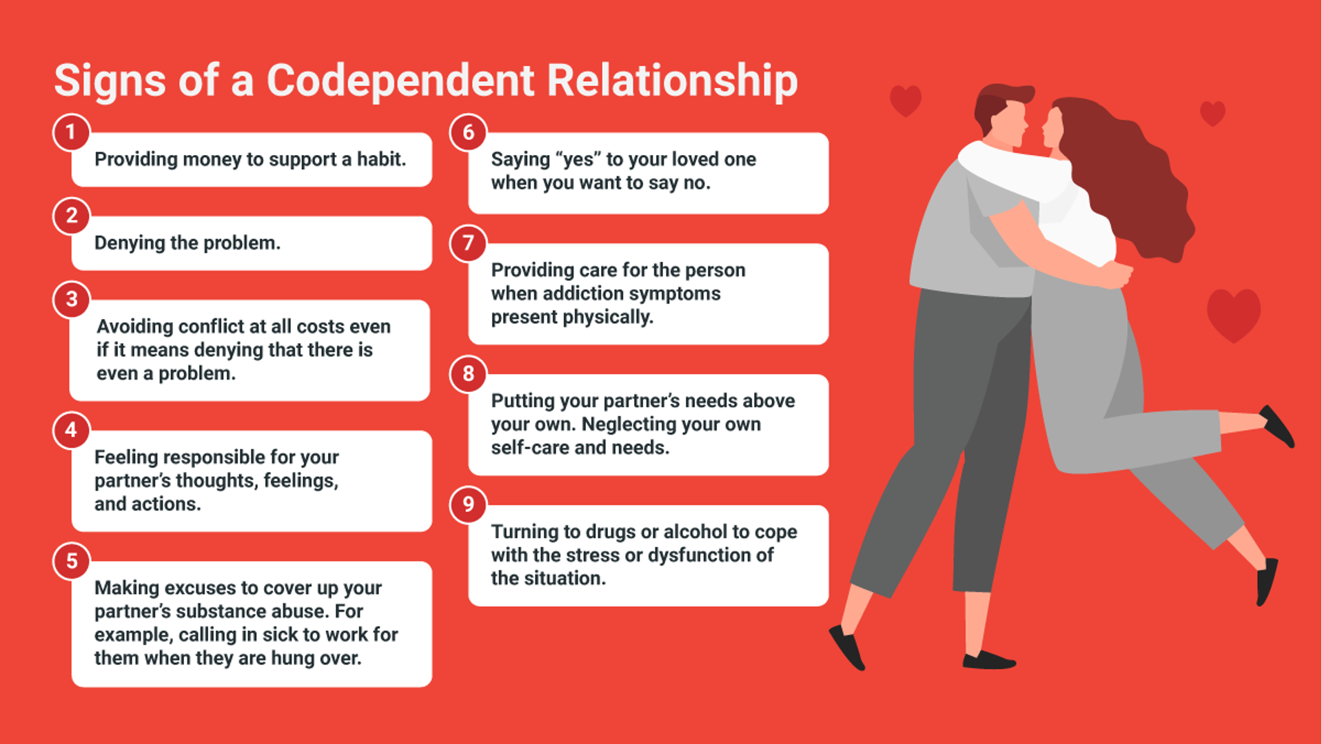

Slide 28
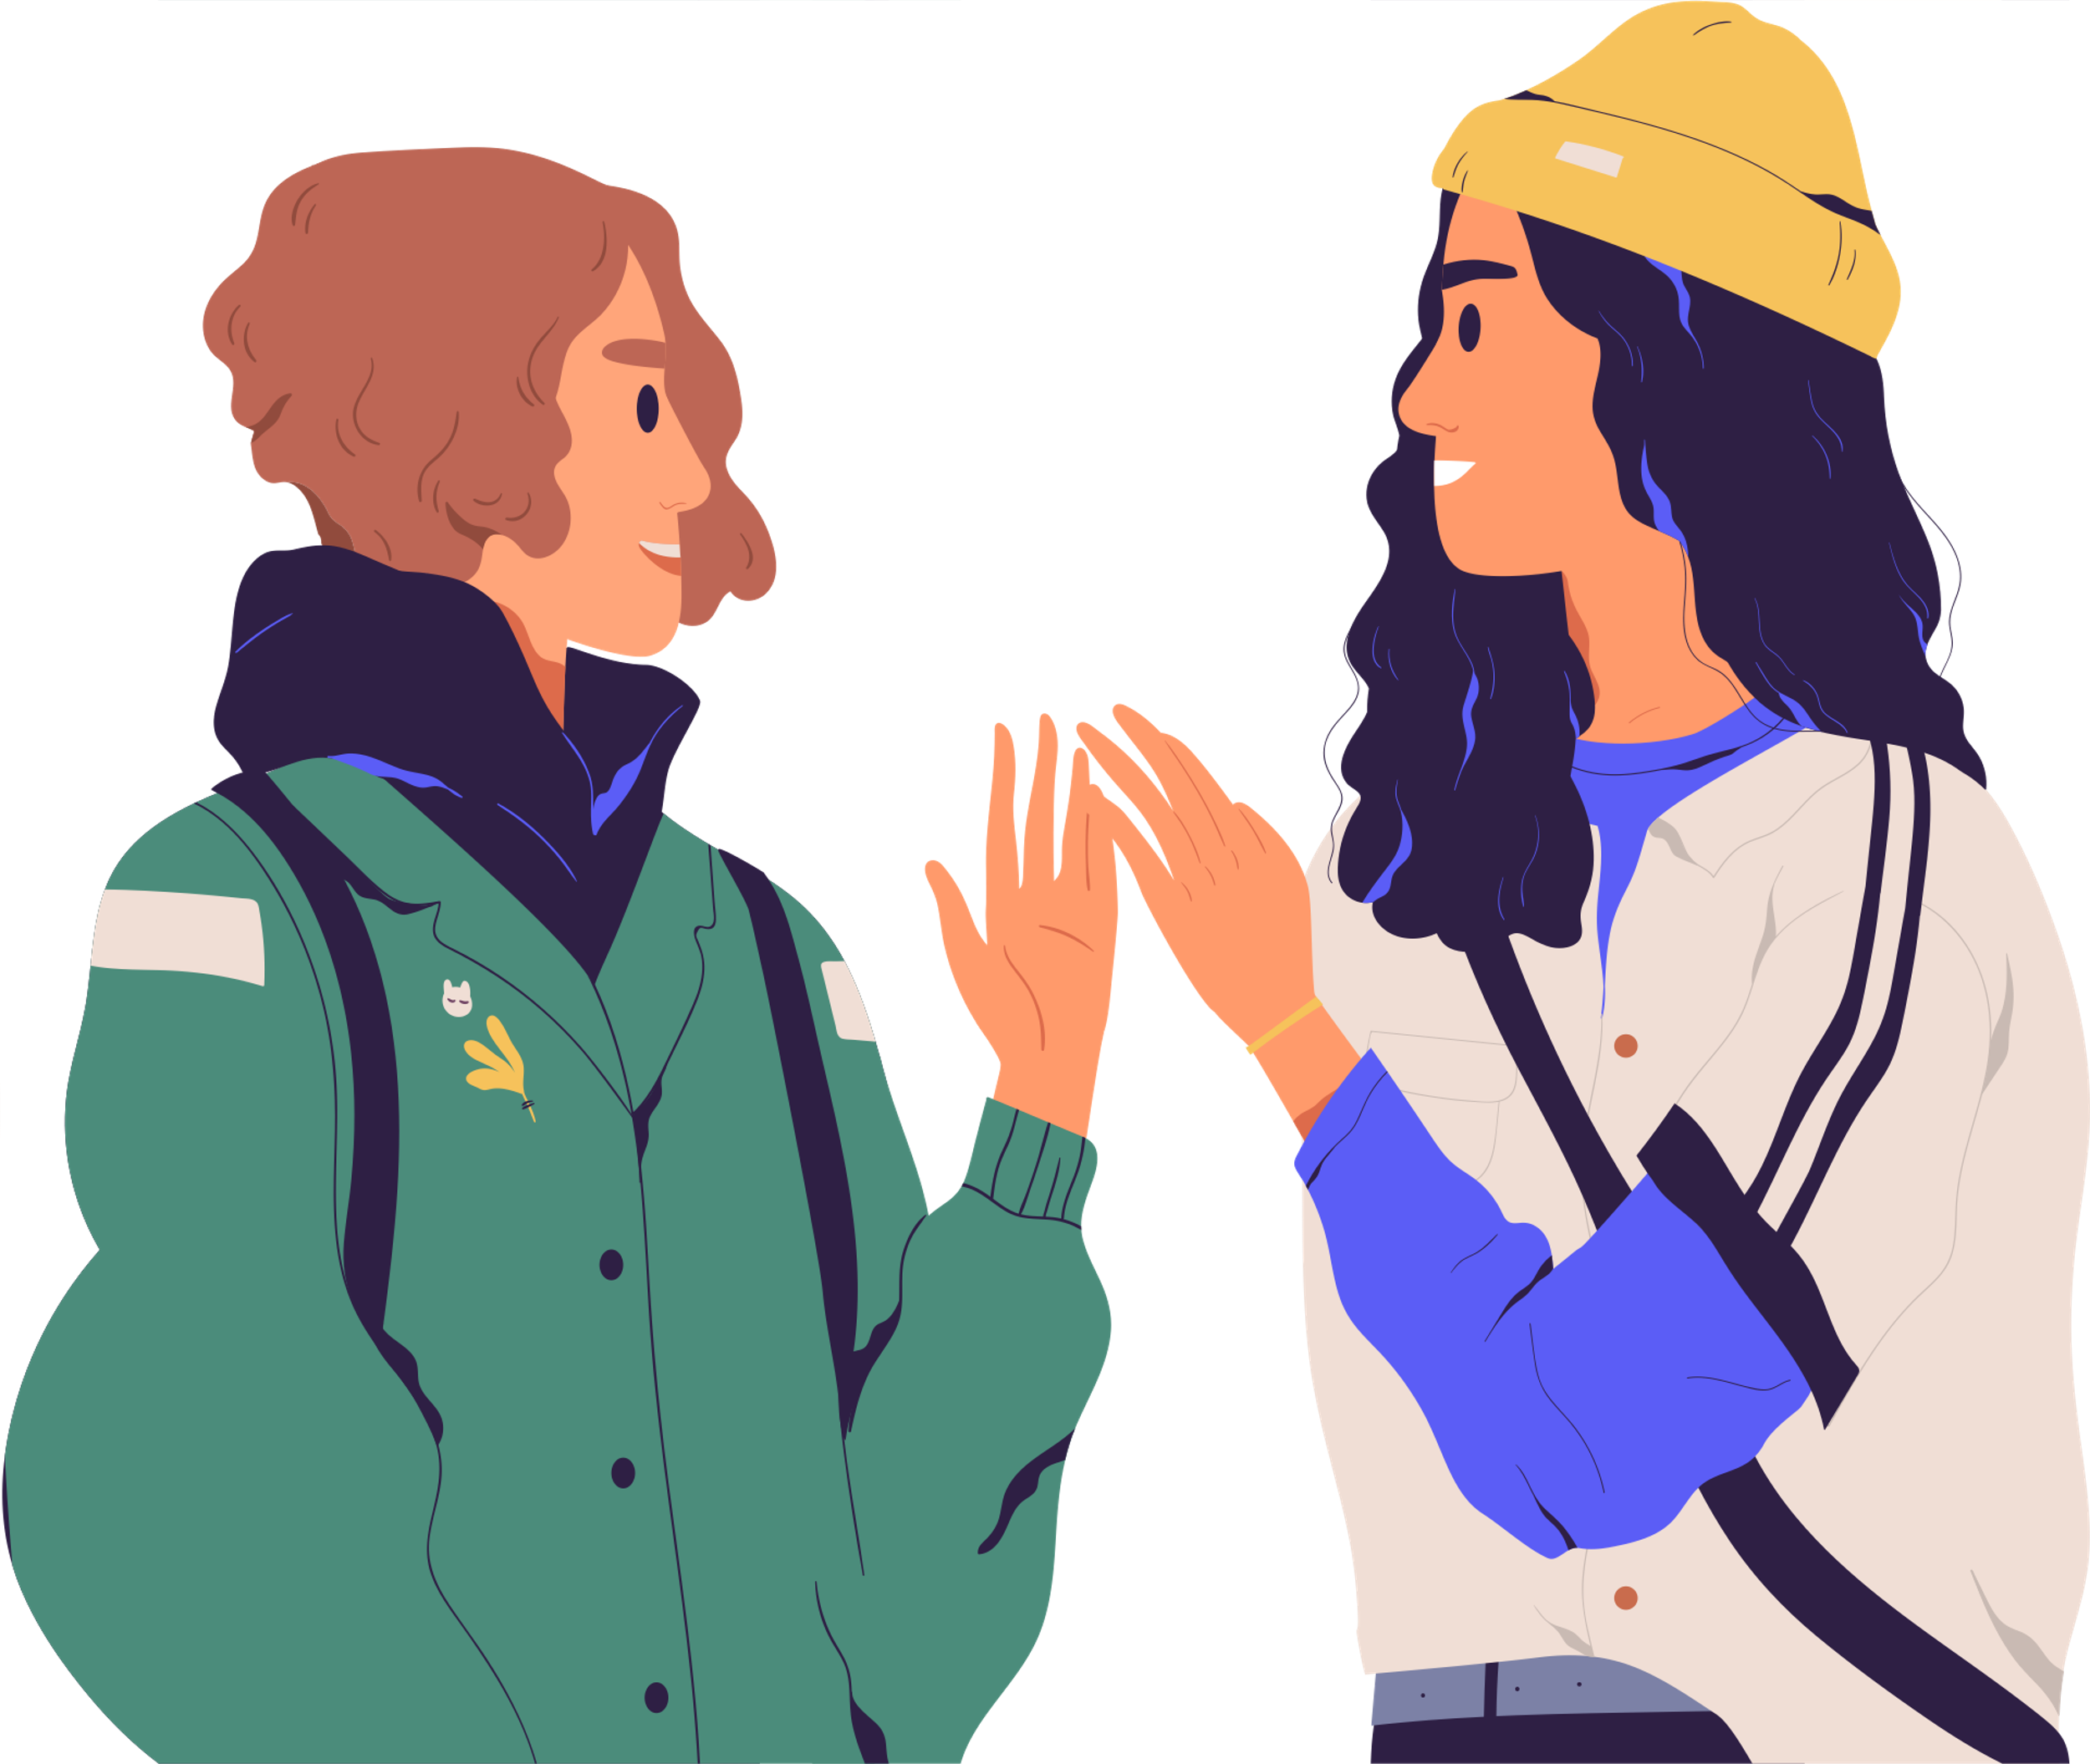
Overcoming
Co-Dependency
Separate showing support from co-dependence
Identify patterns in your life
Learn what healthy love looks like
Set boundaries for yourself
Only you can control your actions
Notes:
The line between healthy, supportive behaviors and codependent ones can sometimes be a bit blurry. After all, it’s normal to want to help your partner, especially if they’re having a tough time.
Once you’ve got a handle on what codependency actually looks like, take a step back and try to identify any recurring patterns in your current and past relationships. Do you have a tendency to gravitate toward people who need a lot of help? Do you have a hard time asking your partner for help?
Signs of healthy love:
partners trust themselves and each other
both partners feel secure in their own self-worth
partners can compromise
Listen with empathy, but stop there. Unless you’re involved with the problem, don’t offer solutions or try to fix it for them.
Practice polite refusals. Try “I’m sorry, but I’m not free at the moment” or “I’d rather not tonight, but maybe another time.”
Question yourself. Before you do something, ask yourself the following questions:
Why am I doing this?
Do I want to or do I feel I have to?
Will this drain any of my resources?
Will I still have energy to meet my own needs?

Slide 29
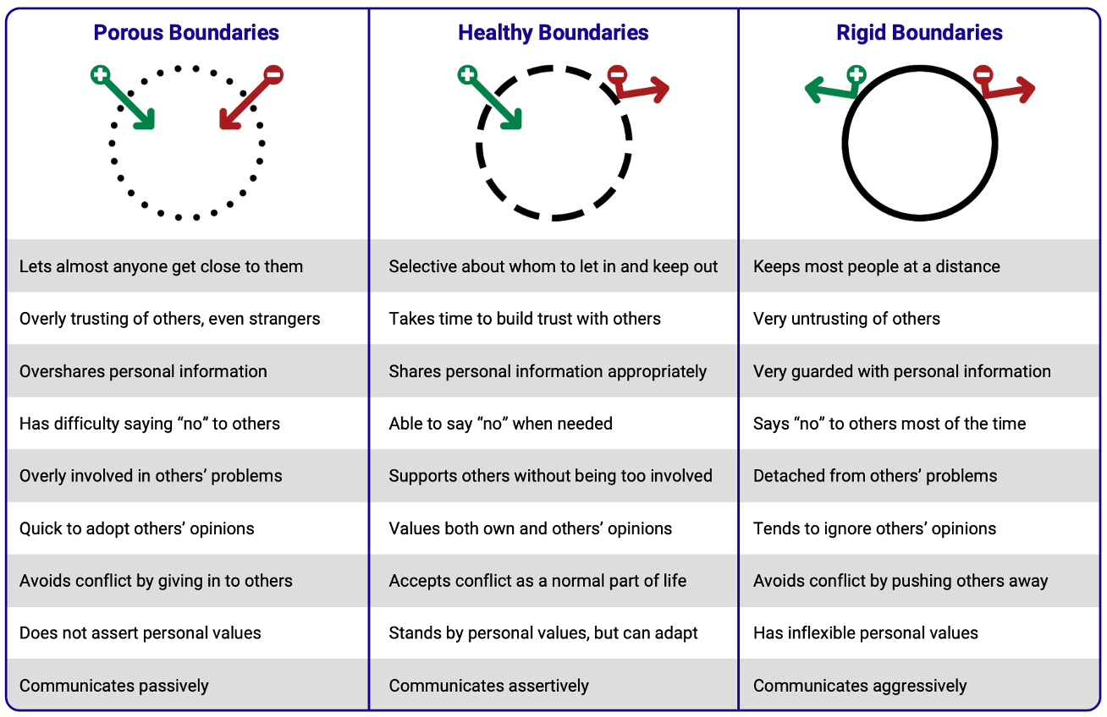
Boundary Styles
Notes:
Personal boundaries are the limits and rules we set in a relationship to define what is acceptable, and what is not. Boundaries are influenced by our values and culture. Boundaries—which can be porous, healthy, or rigid—may differ from relationship to relationship.
Someone with porous boundaries lets almost anyone get close to them, while someone with rigid boundaries keeps almost everyone at a distance. By contrast, someone with healthy boundaries is selective about whom to let in and keep out. Healthy boundaries allow a person to form close, safe, and trusting relationships while remaining true to their own values and needs.

Slide 30
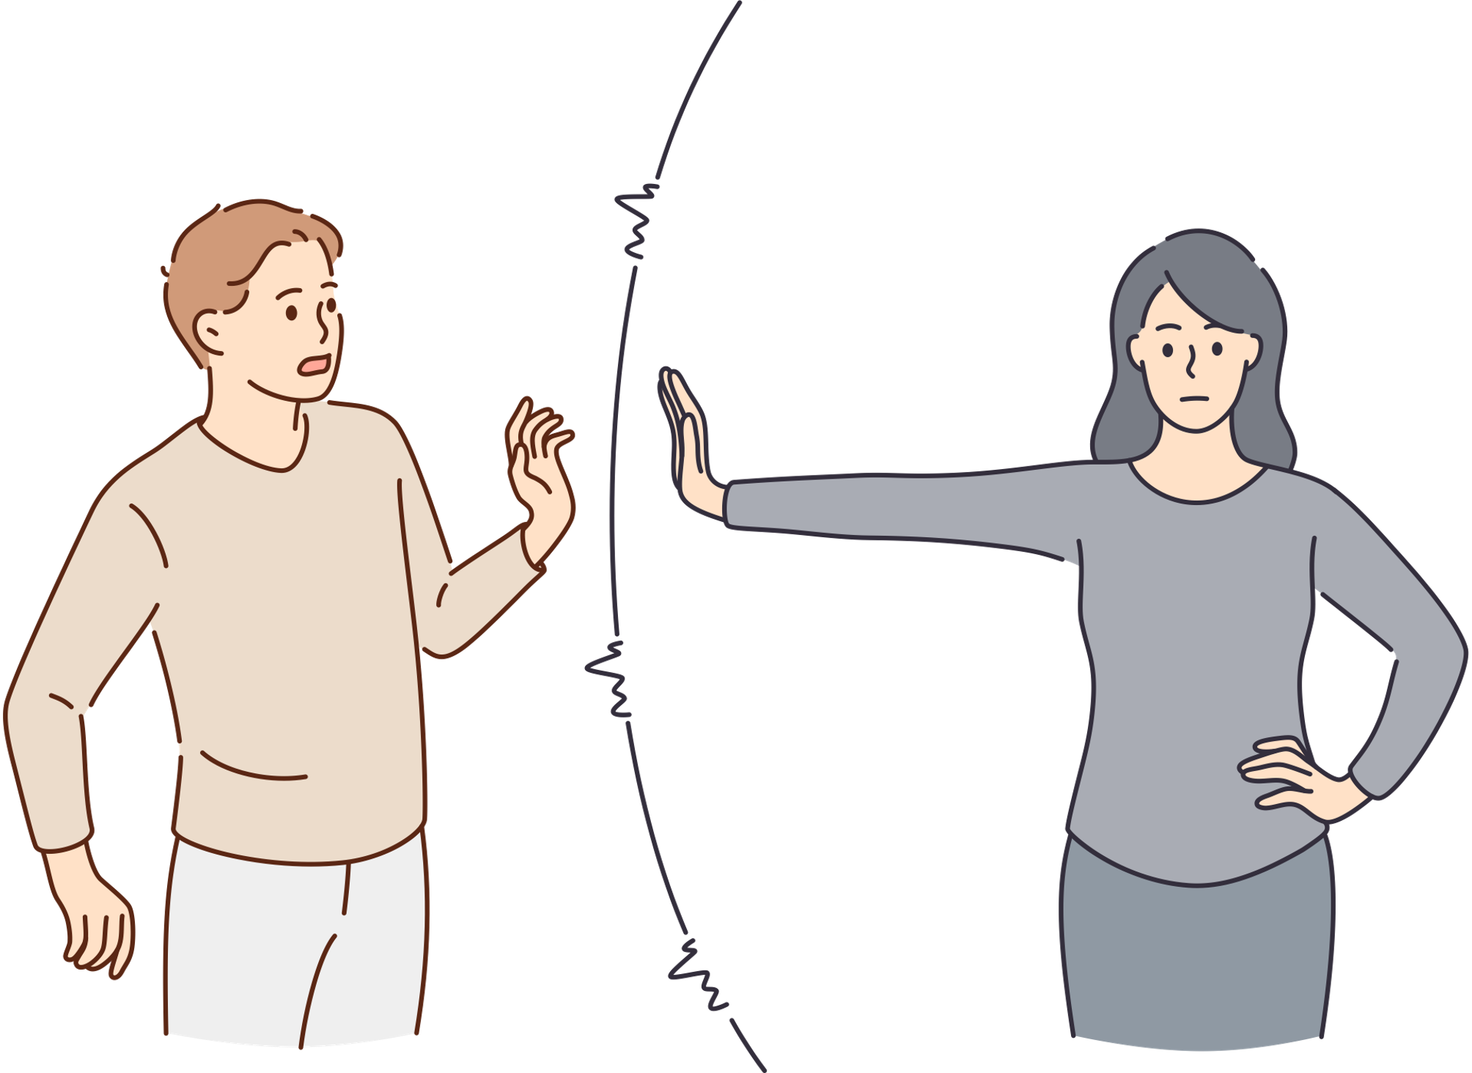
Setting Boundaries
Know Your Boundaries
Should be based on your values, or the things that are important to you.
Plan Ahead
Set them before entering a situation. This will make it less likely you’ll do something you’re not comfortable with.
Express Yourself
Make it clear so there is no doubt about what you want.
Be confident and show it in your body language
Be Respectful
Avoid yelling, using put-downs, or giving the silent treatment.
Notes:
Personal boundaries are the limits and rules we set for ourselves within relationships. A person with healthy boundaries can say “no” to others when they want to, but they are also comfortable opening themselves up to intimacy and close relationships.

Slide 31
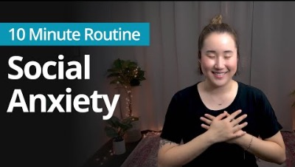
Mindful Moment
Notes:
https://www.youtube.com/watch?v=xr0Gpp7JH3I

